Slide 1
Applied Machine learning
Regent College London
SWE6302

Slide 2
Applied Machine learning
SWE6302

Slide 3

Machine learning
More About Deep Learning

Slide 4
Module 1 – Deployment of Machine Learning Models and Introduction to Deep Learning

Slide 5
Learning objectives
Understand the core concepts of DL
Understand Artificial Neural Network (ANN)
Understand Perceptron
Understand Convolutional Neural Network (CNN)

Slide 6
Recap - AI, ML, Dl
Artifical
Artificial Intelligence is the capability of a machine to imitate intelligent human behaviour.
AI is achieved by mimicking a human brain, by understanding how it thinks, how it learns, decides, and work while trying to solve a problem.
Artificial Intelligence
Machine Learning
is a subset of
Artificial Intelligence
Machine learning focuses on developing algorithms that allow computers to learn from data and make predictions or decisions without being explicitly programmed.
Machine Learning
Deep Learning
Deep Learning
is a subset of
Machine Learning
Deep Learning uses neural networks to simulate human like decision making

Slide 7
Simplified Diagrammatic Implementation of ML
Training Data
Machine Learning Algorithm
Training
Prediction
“Live” Data / Test Data
Trained Model
Prediction

Slide 8
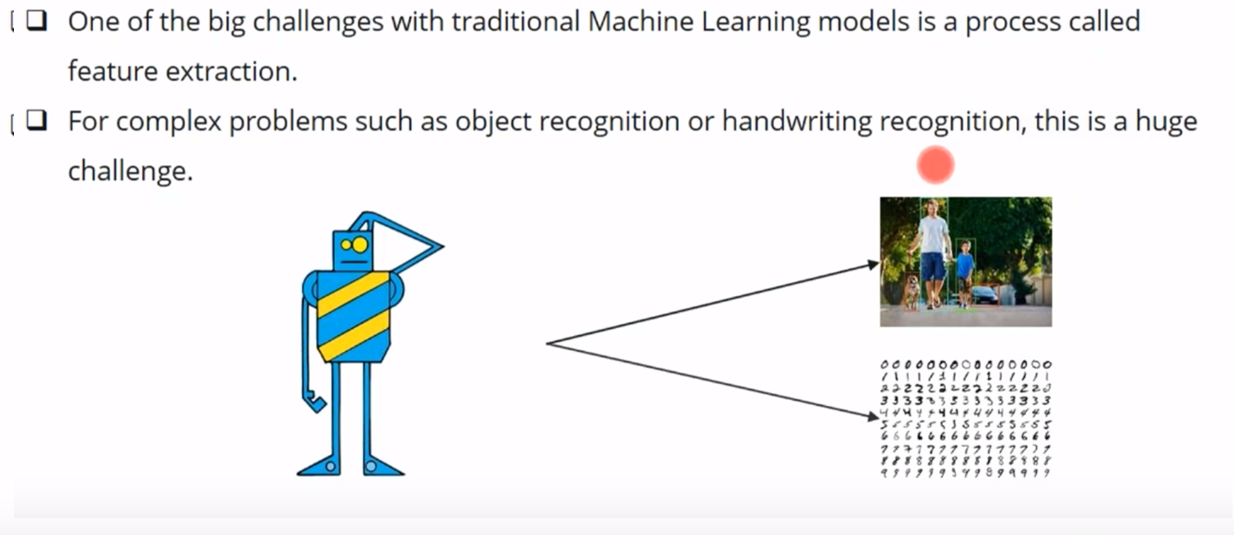
Limitations of ML

Slide 9
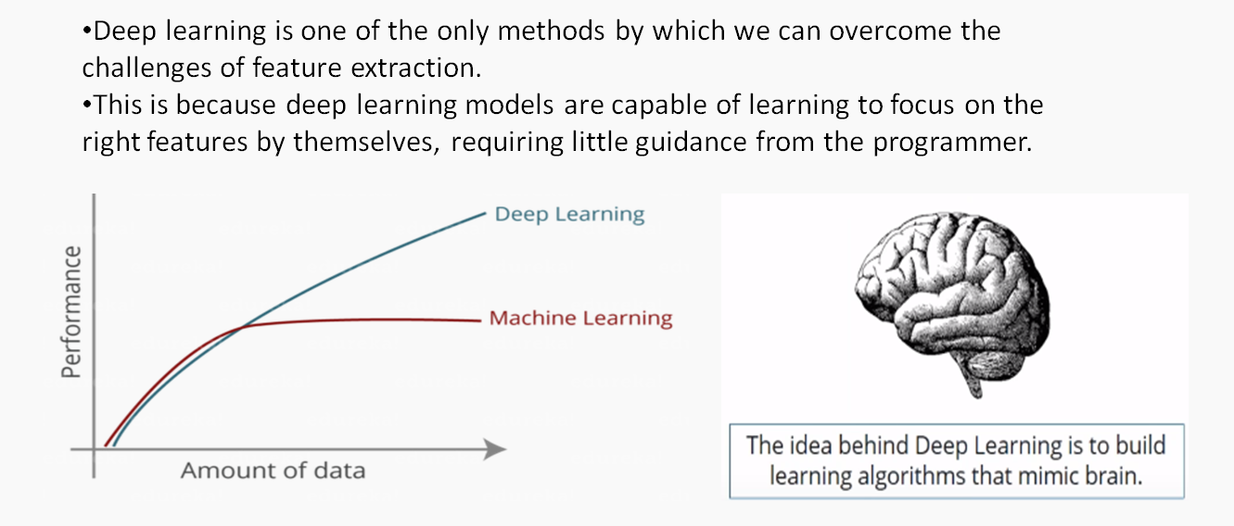
Deep Learning (DL) to the rescue

Slide 10
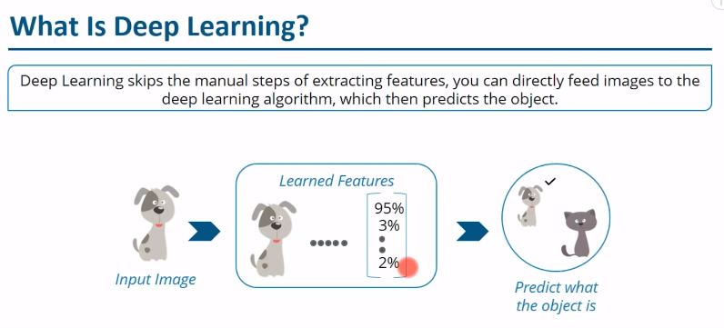
What is Deep Learning (An example)

Slide 11
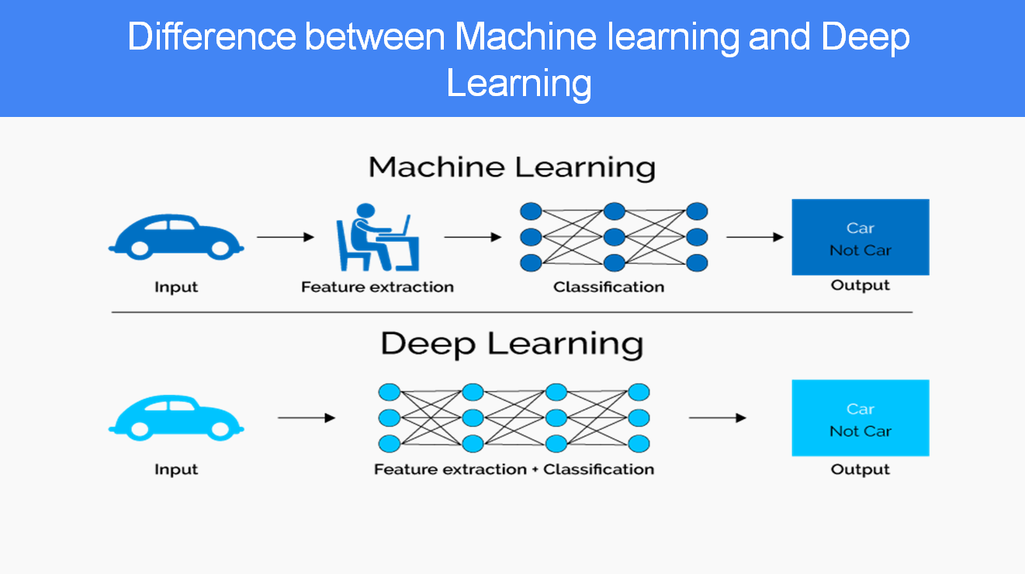
Difference between DL and ML

Slide 12
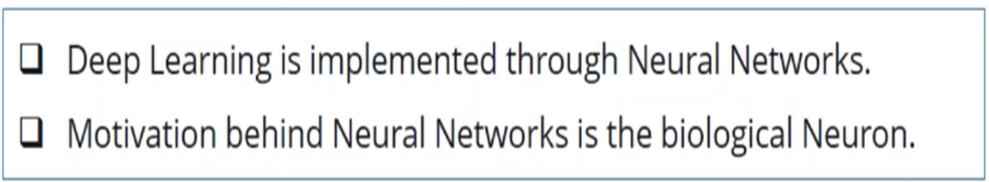
Deep Learning

Slide 13
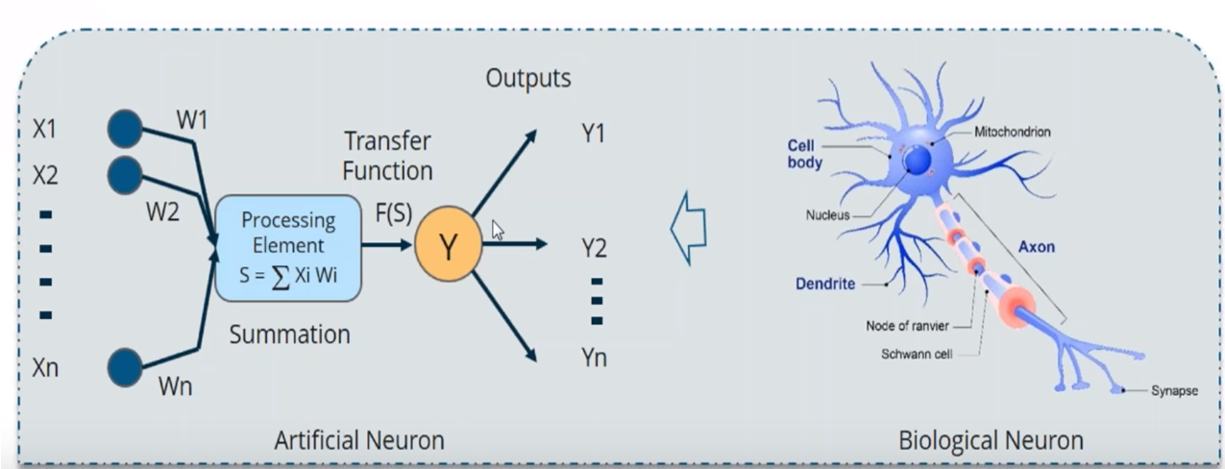
Artificial Neuron in DL

Slide 14
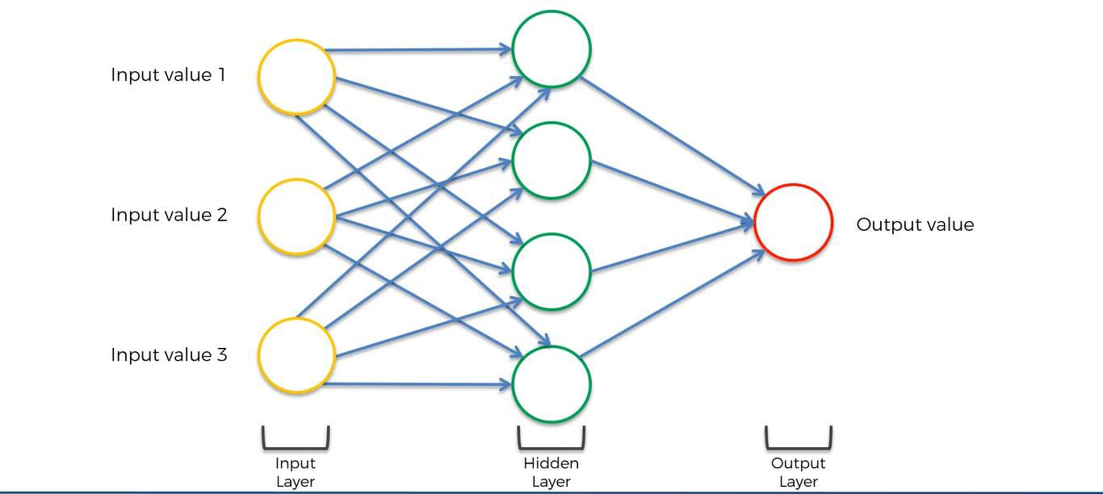
Introduction to Artificial Neural Network (ANN)

Slide 15
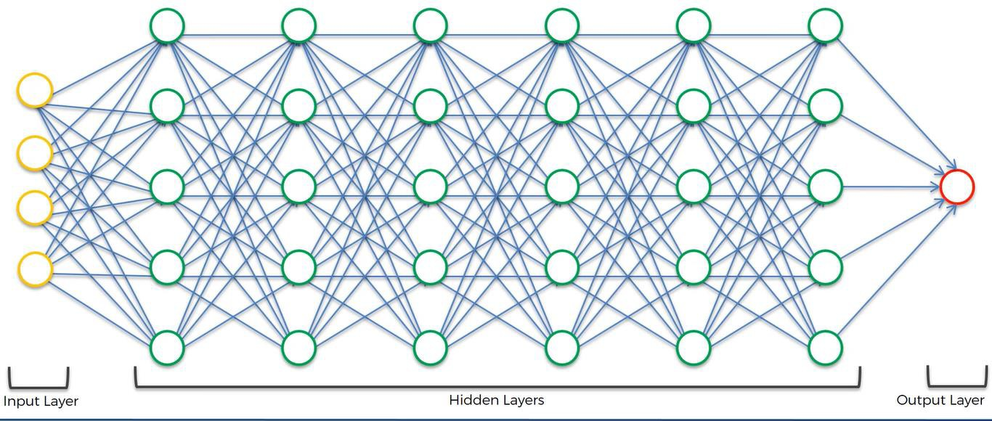
Deep Neural Network in DL
When artificial neural networks (ANN) has multiple hidden layers (hence called "deep"), it forms the basis for Deep Neural Network (DNN).
The field where DNN is used is called Deep Learning.

Slide 16
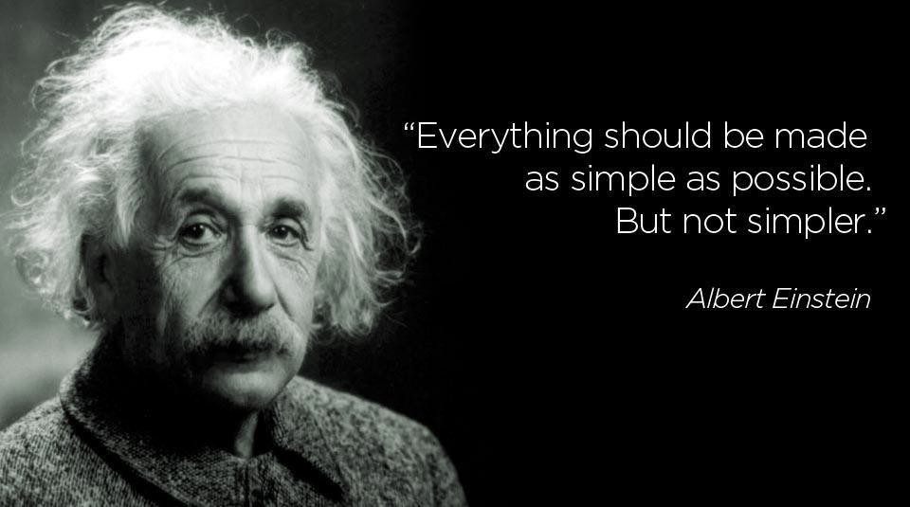
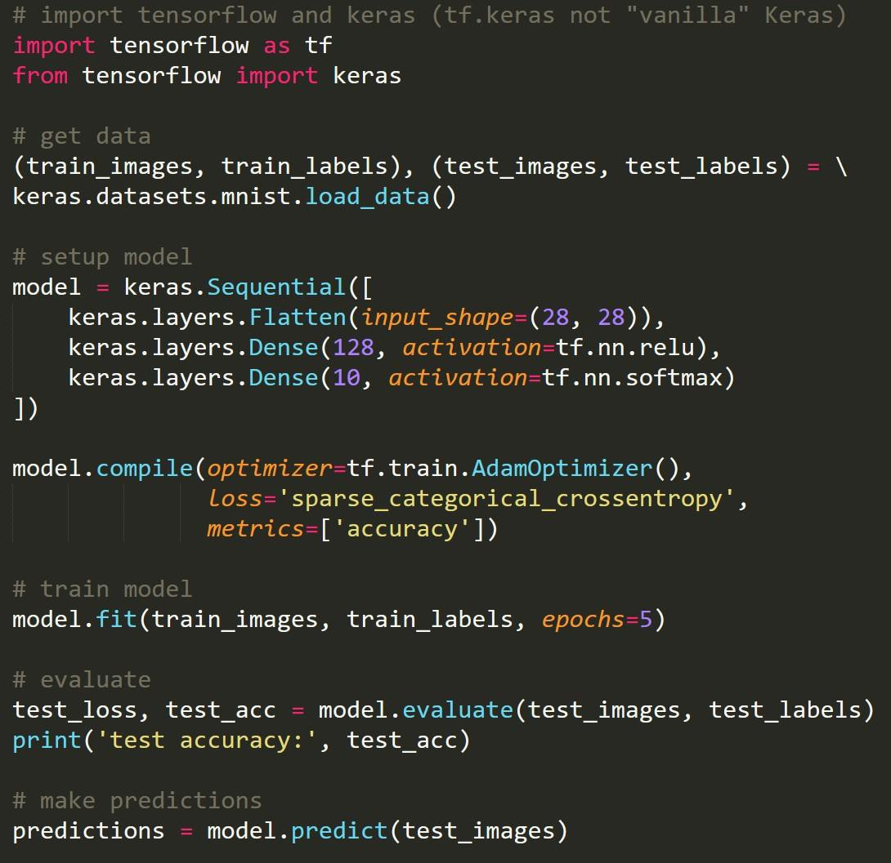

First Steps: Start Simple
1
2
3
4
Input Image:
5
TensorFlow
Model:
Neural
Network
6
5
(with 87% confidence)
7
Output:
6
Access Google Colab Notebook: https://colab.research.google.com/drive/1mB_IFQAd7qbMAhQ2C23a2NEbrNSl_i3R?usp=sharing

Slide 17
In Summary - ML vs DL
Machine learning focuses on developing algorithms that allow computers to learn from data and make predictions or decisions without being explicitly programmed. It includes techniques like supervised learning, unsupervised learning, semi-supervised and reinforcement learning. Machine learning models often rely on structured data and require human intervention for tasks like feature engineering.
Deep learning, on the other hand, is a specialized branch of machine learning that uses artificial neural networks with multiple layers (hence called "deep"). These networks are designed to mimic the structure and functioning of the human brain. Deep learning excels at handling large datasets and complex tasks such as image recognition, natural language processing, and autonomous systems. Unlike traditional machine learning, deep learning models automatically extract features from raw data, reducing the need for manual feature engineering.

Slide 18
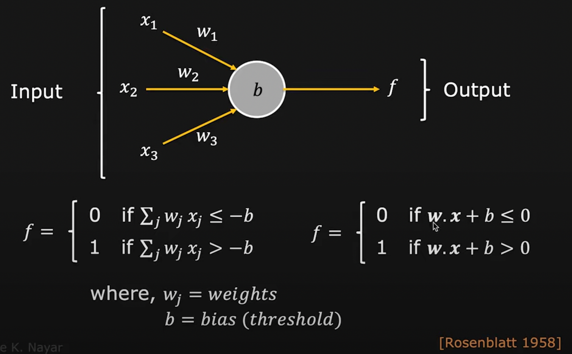
Simplest representation of an Artificial Neuron: Perceptron

Slide 19

Perceptrons
Rosenblatt introduced weights 𝑤₁, 𝑤₂,…, which are real numbers
expressing the importance of the respective inputs to the output.
The neurons output, 0 or 1, is determined by whether the weighted sum Σ_{𝑗}𝑤_{𝑗}𝑥_{𝑗} is less than or greater than some threshold value.
Just like the weight, the threshold is a real number which is a parameter of the neuron.

Slide 20
Perceptron Example
Suppose the weekend is coming up, and you've heard that there's going to be a cheese festival in your city. You like cheese and are trying to decide whether or not to go to the festival. You might make your decision by weighing up three factors:
Is the weather good?
Does your boyfriend or girlfriend want to accompany you?
Is the festival near public transit? (You don't own a car).

Slide 21
Perceptron Example
We can represent these three factors by corresponding binary variables 𝑥₁, 𝑥₂ and 𝑥₃ . For instance, we'd have 𝑥₁ =1 if the weather is good, and 𝑥₁ =0 if the weather is bad. Similarly, 𝑥₂=1 if your boyfriend or girlfriend wants to go, and 𝑥₂=0 if not. And similarly, again for 𝑥₃ and public transit.
Now, suppose you absolutely adore cheese, so much so that you're happy to go to the festival even if your boyfriend or girlfriend is uninterested and the festival is hard to get to.

Slide 22
Perceptron Example
But perhaps you really loathe bad weather, and there's no way you'd go to the festival if the weather is bad.
You can use perceptrons to model this kind of decision-making. One way to do this is to choose a weight for the weather w1=6, and w2=2 and w3=2 for the other conditions.
The larger value of w indicates that the weather matters a lot to you, much more than whether your boyfriend or girlfriend joins you, or the nearness of public transit.
Finally, suppose you choose a threshold of for the perceptron.
With these choices, the perceptron implements the desired decision-making model, outputting whenever the weather is good, and whenever the weather is bad.
It makes no difference to the output whether your boyfriend or girlfriend wants to go, or whether public transit is nearby.

Slide 23
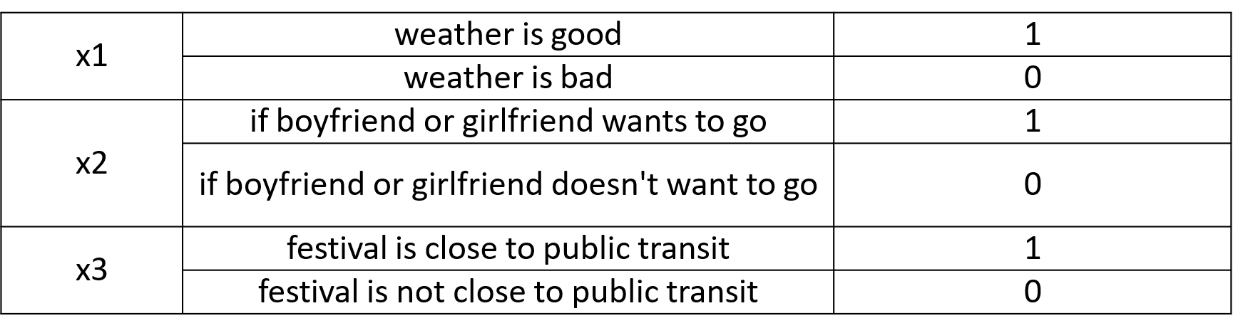
Perceptron Example

Slide 24
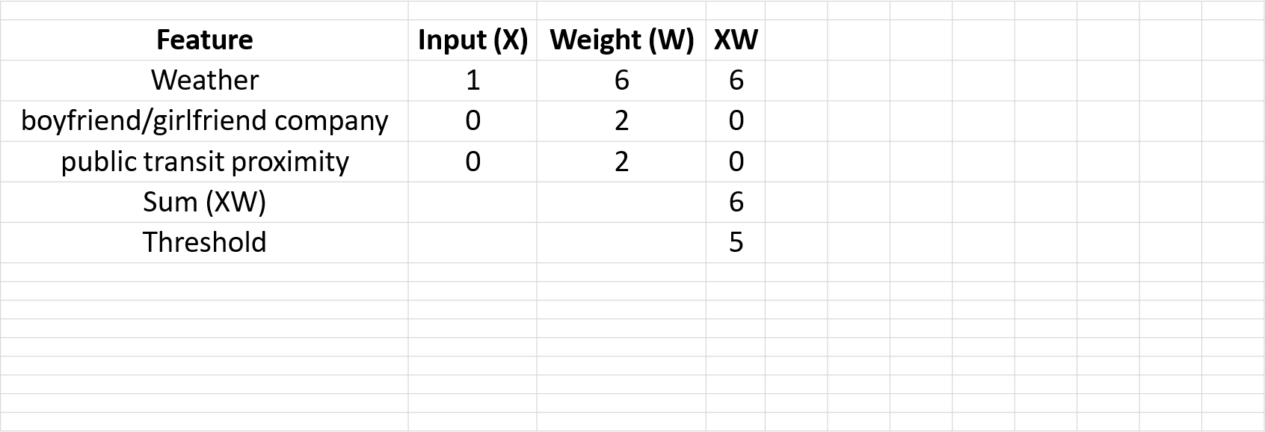
Perceptron Example

Slide 25
Classroom Group Exercise
Taking the same example of the festival visit, in a group, what do you think will be the answer to visit the festival if the following data are given:
Weather is bad
boyfriend or girlfriend wants to go
festival is close to public transit
You have 10 minutes to discuss this in your group and present the working solution in a powerpoint.

Slide 26
Perceptron and Neural Networks
Threshold = - bias (b)
Σ_{𝑗}𝑤_{𝑗}𝑥_{𝑗} + b = 0
Fundamental Eqn for Neural Networks

Slide 27
Deep Learning – Multiple Layers of Neurons
Example shown in Google Colab Notebook: https://colab.research.google.com/drive/1mB_IFQAd7qbMAhQ2C23a2NEbrNSl_i3R?usp=sharing

Slide 28
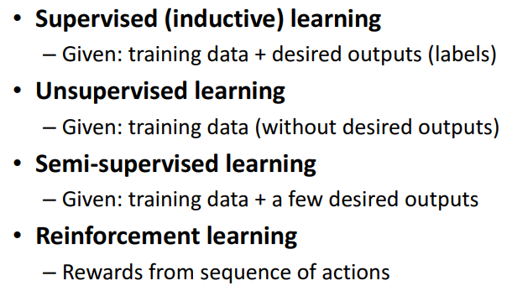
Types of Machine Learning

Slide 29
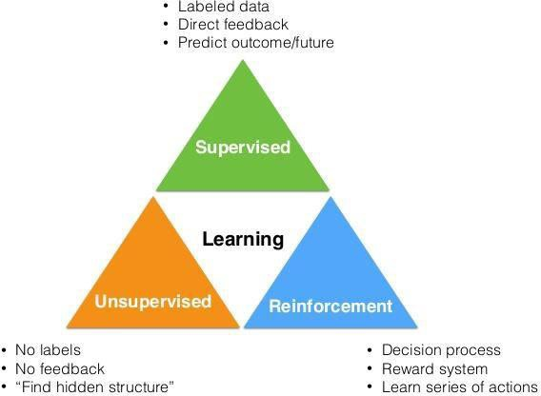
Supervised Learning withNeural Networks
There's been a lot of hype about neural networks and perhaps some of that hype is
justified given how well they're working.
But it turns out that so far almost all the economic value created by a neural networks has been through one type of machine learning called supervised learning.

Slide 30
Supervised Learning withNeural Networks
Youhave some input Xand you want to learn the function mapping tosome output Y.
For example, just now we saw the housing price prediction application where you input some features of a home and try to output or estimate the price Y.
The single most lucrative application of deep learning today is online advertising. Neural networks have gotten very good at predicting whether or not you click
on an ad and by showing you and showing users the ads that you're most likely to click on.
Youmight input an image andwant to output an index from one to a thousand trying to tell you if this picture might be any one of a thousand different images so you might use that for phototagging.
The recent progress in Speech recognition has also been very exciting where you can now input an audio clip to, a neural network can have it output a text transcript.
Machine translation has also made huge strikes thanks to deep learning where now you can have an Englishsentence input to a neural network and directly
output their Chinesesentence.
In Autonomous driving you might input then say a picture of what's in front of your car as well as some information from a radar and based on that maybe in your network can be trained to tell you the position of the other cars on the road so this becomesa key component in autonomous driving systems.
Input(x) Output(y) Application
Home features Ad, user info Image
Audio English
Image, Radarinfo
Price
Click on ad?(0/1)
Object (1,….,1000)
Text transcript Chinese
Position of othercars
Real Estate Online Advertising Photo tagging Speech recognition Machine translation
Autonomousdriving
Multi Layer Neural Network
Convolutional Neural Network
Recurrent Neural Network
Custom / Hybrid Neural Network

Slide 31
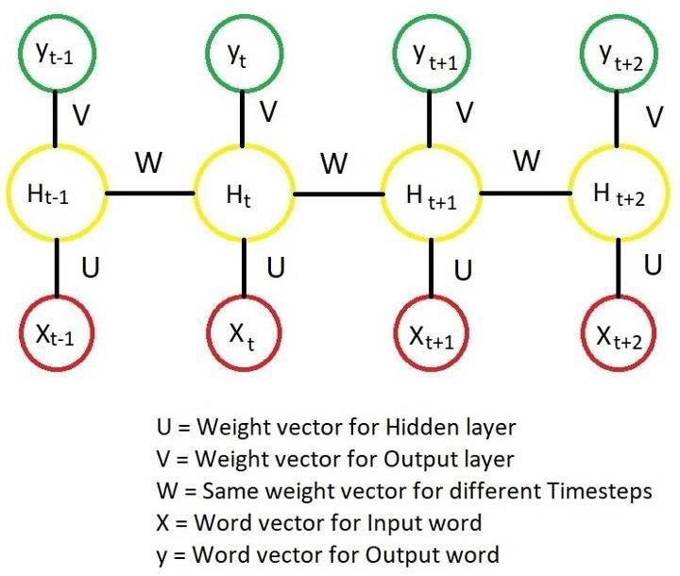
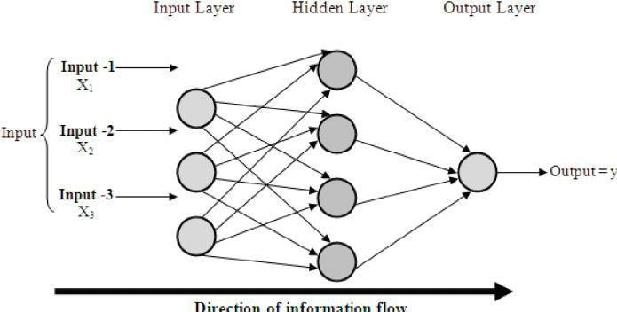
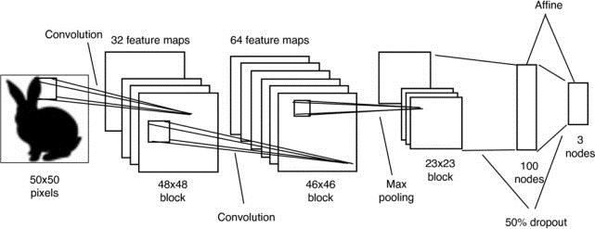
Supervised Learning withNeural Networks
Neural Network examples
Multi Layer Neural Network (MLNN)
Convolutional Neural Network (CNN)
Recurrent Neural Network (RNN)

Slide 32
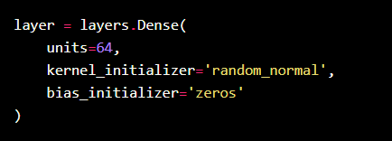
Initialisers (Kernel and Bias)
RandomNormal class
RandomUniform class
TruncatedNormal class
Zeros class
Ones class
GlorotNormal class
GlorotUniform class
HeNormal class
HeUniform class

Slide 33
Activation Function
relu function
sigmoid function
softmax function
softplus function
softsign function
tanh function
selu function
elu function
exponential function

Slide 34
How Neural Networks Learn: Backpropagation
Forward Pass:
Input
Data
Neural
Network
Prediction
Backward Pass (aka Backpropagation):
Neural
Network
Measure
of Error
Adjust to Reduce Error

Slide 35
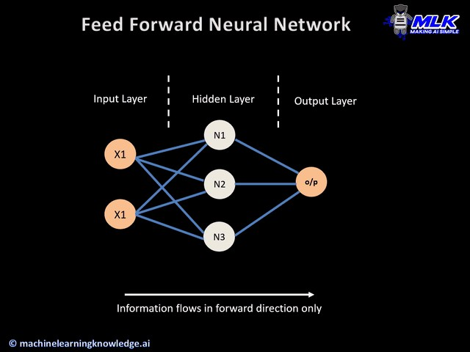
Feed Forward Neural Network

Slide 36
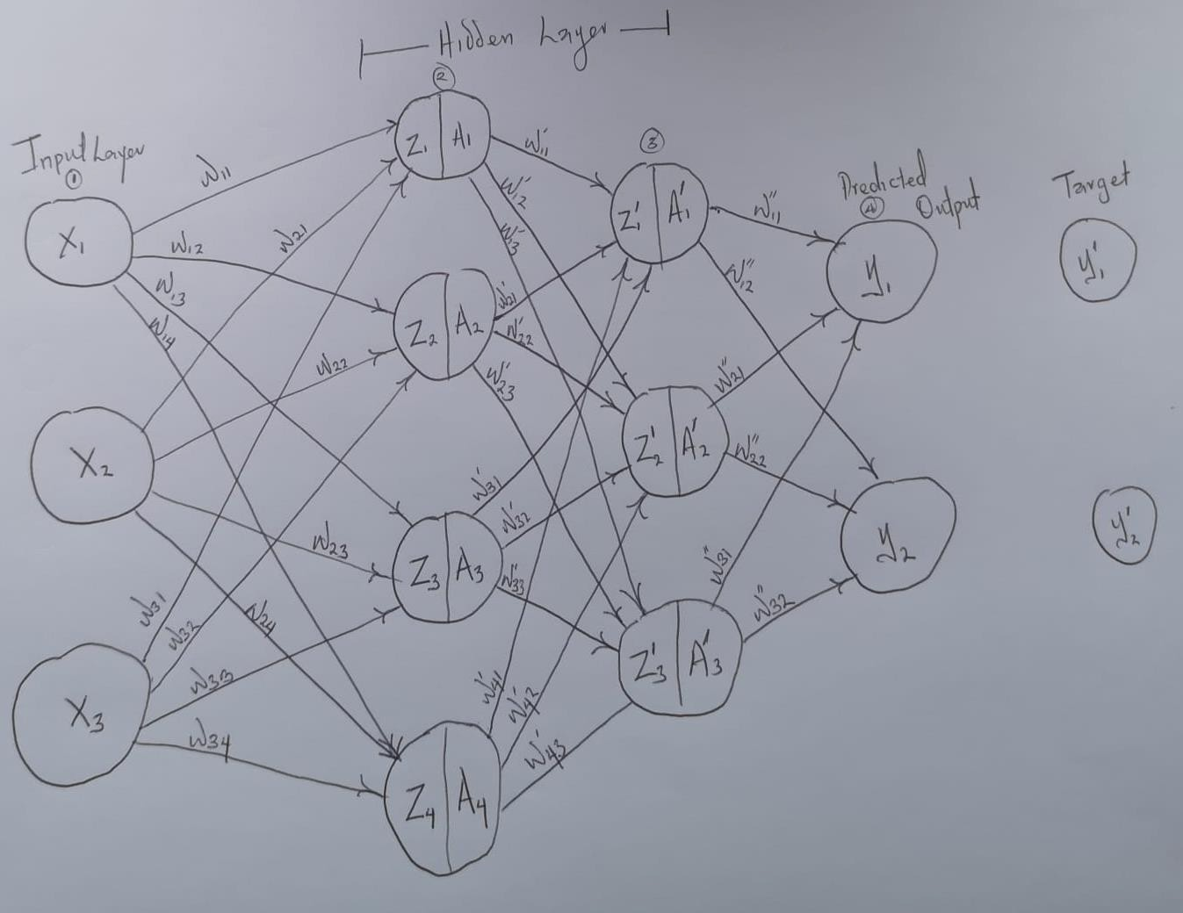
Forward Propagation
Forward propagation is the way data moves from left (input layer) to right (output layer) in the neural network

Slide 37
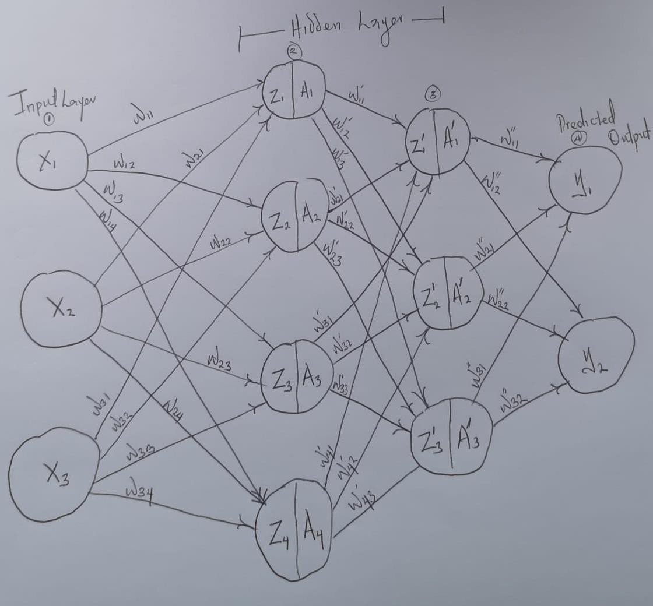
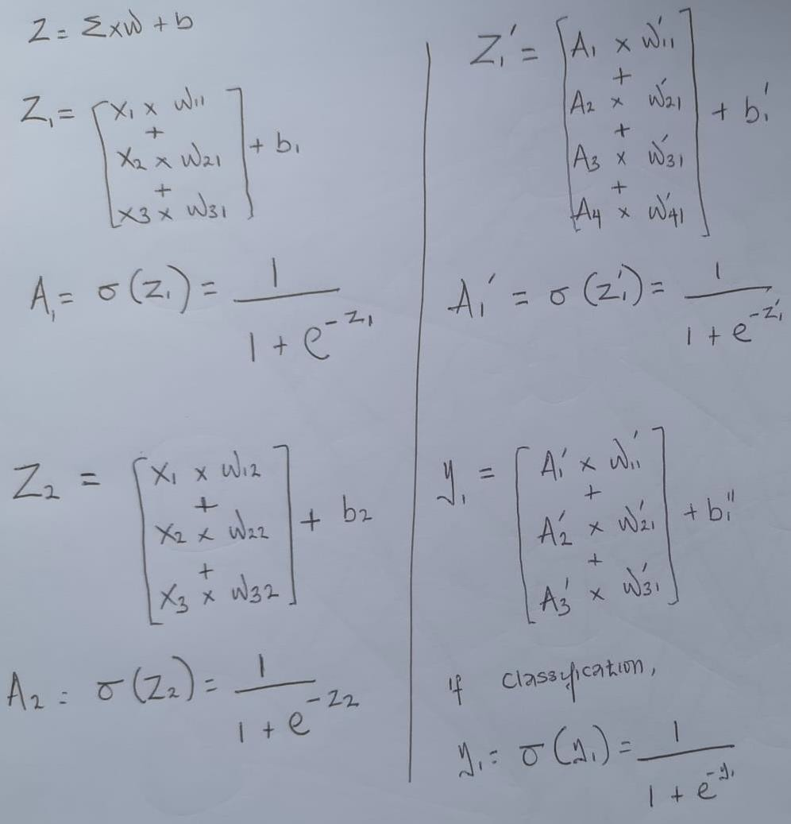
Forward Propagation

Slide 38
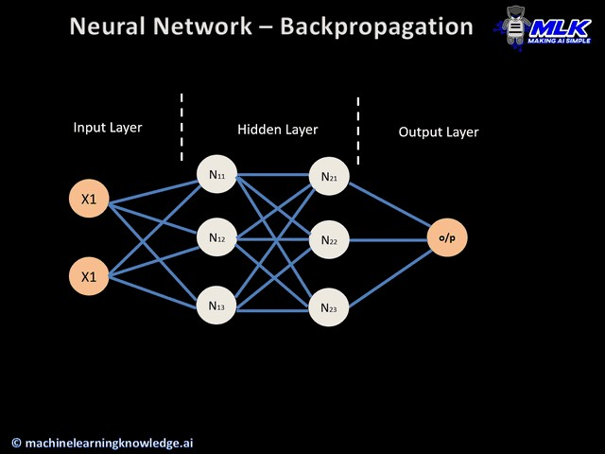
Back Propagation
Backpropagation, or backward propagation of errors, is an algorithm that is designed to test for errors working back from output nodes to input nodes.

Slide 39
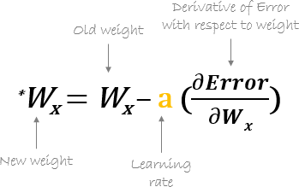
Back Propagation
Repeat until error derivative is closest to zero

Slide 40
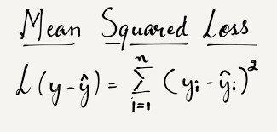
Back propagation – Loss Function
Measure loss between the predicted and the target output
Mean Squared Error Loss function

Slide 41
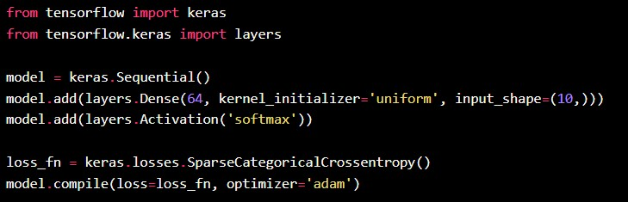
Loss Function - Regression
MeanSquaredError class
MeanAbsoluteError class
MeanAbsolutePercentageError class
MeanSquaredLogarithmicError class
CosineSimilarity class
mean_squared_error function
mean_absolute_error function
mean_absolute_percentage_error function
mean_squared_logarithmic_error function
cosine_similarity function
Huber class
huber function
LogCosh class
log_cosh function

Slide 42
Loss Function - Probabilistic
BinaryCrossentropy class
CategoricalCrossentropy class
SparseCategoricalCrossentropy class
Poisson class
binary_crossentropy function
categorical_crossentropy function
sparse_categorical_crossentropy function
poisson function
KLDivergence class
kl_divergence function

Slide 43
Optimisers
SGD
RMSprop
Adam
Adadelta
Adagrad
Adamax
Nadam
Ftrl

Slide 44
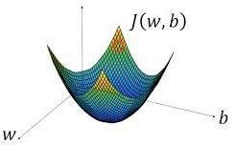
GradientDescent
Gradient Descent is a process of trying to minimize the error function.
Gradient descent algorithm is been used to train and also learn the parameters W on your training set.
In order to learn the set of parameters W and Bit seems natural that we want to find W and Bthat make the cost function J(W, b) as sma l.

Slide 45
GradientDescent
How does Gradient Descent Work
Gradient Descent starts at an initial point and begins taking steps inthe steepest downhill direction.
After a single step, you might end up there because it’s trying to take a step downhill in the direction of steepest descent or quickly down low as possible.
S o, after one and two iterations of gradient descent, you might end up with the third iteration and so on, until eventually, hopefully you converge to this global optimum or get to something close to the global optimum.

Slide 46
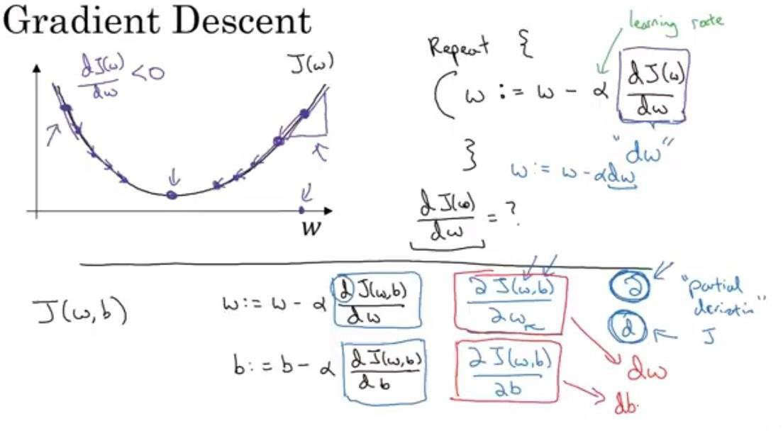
GradientDescent
When derivative is positive.
The learning rate controls how big astep we take on each iteration of gradient descent
Derivative is basically the update of the change you want to make to the parameters W
When derivative
is negative.
Note : in our code ‘ dw ’ will be used to represent this derivative term.
Derivative is the slope of a function at the point.

Slide 47
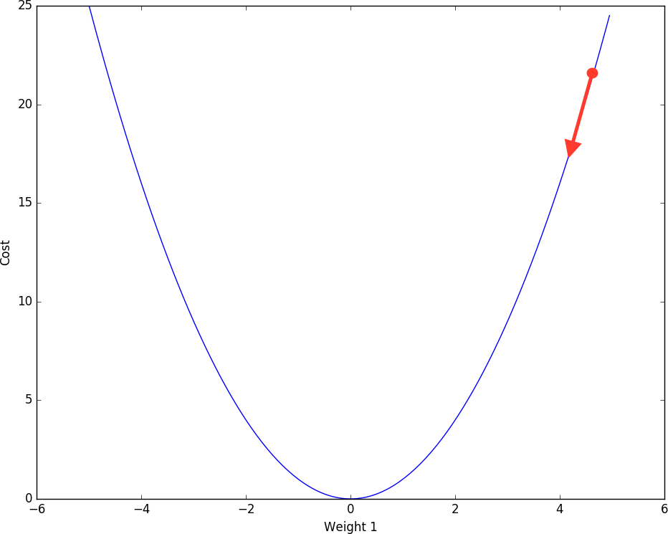
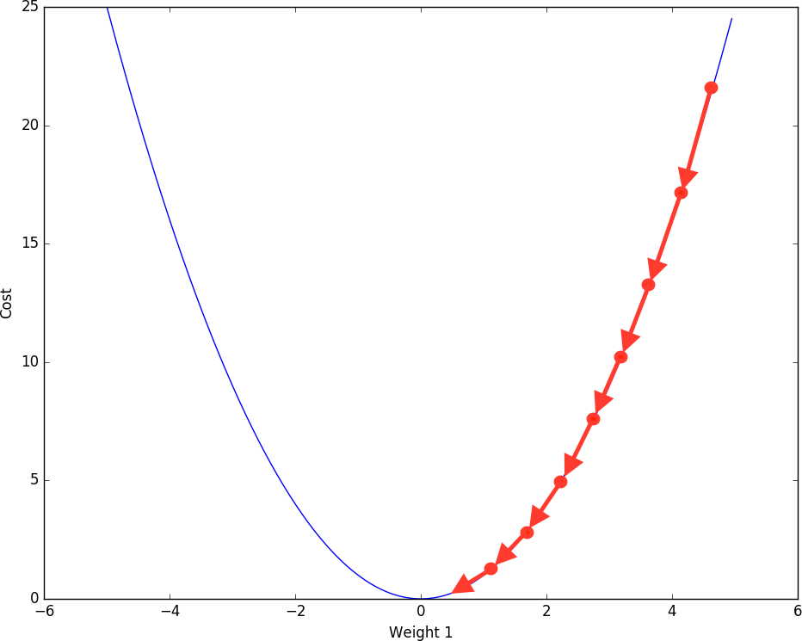
GradientDescent - Learning is an Optimization Problem
Task: Update the weights and biases to decrease loss function
SGD: Stochastic Gradient Descent

Slide 48
GradientDescent - Learning is an Optimization Problem
Explanation for the graph.
Here the derivative is positive, “ W “ gets updated as “ W “ minus a learning rate times the derivative. We know the derivative is positive, so we end up subtracting from W and taking a step to the left. Here, gradient descent would make your algorithm slowly decrease the parameter, if you have started off with this large value of W.
Here the derivative is negative, the gradient descent update would subtract alphatimes a negative number and so we end up slowly increasing W and end up you're making W bigger and bigger with successive iterations of gradient descent
So that hopefully whether you initialize on the left or on the right, gradient descent would move you towards this globalminimum.

Slide 49
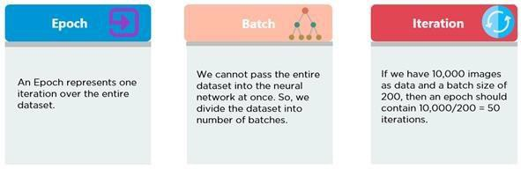
Mini-Batch Size in Neural Network
Mini-Batch size: Number of training instances the network evaluates per weight update step.
Larger batch size = more computational speed
Smaller batch size = (empirically) better generalization
“Training with large minibatches is bad for your health. More importantly, it's bad for your test error. Friends don’t let friends use minibatches larger than 32.”
- Yann LeCun
Revisiting Small Batch Training for Deep Neural Networks (2018)

Slide 50
Summary
Deep Learning (DL) may seem intimidating at first with a lots of integration parts to understand but once individual elements of DL are mastered, DL becomes an important tool in the modern machine learning techniques.

